Slide 1


A Fabulously Fun Word Game App for Parties! (*Legally Distinct [We Hope!] from the “Other Game” that shall Remain Unnamed!)
Team Missile Panthers: Erik Hurst, Brittany Flanagan, Jacinda Power, Kathy Giebelhausen

Slide 2

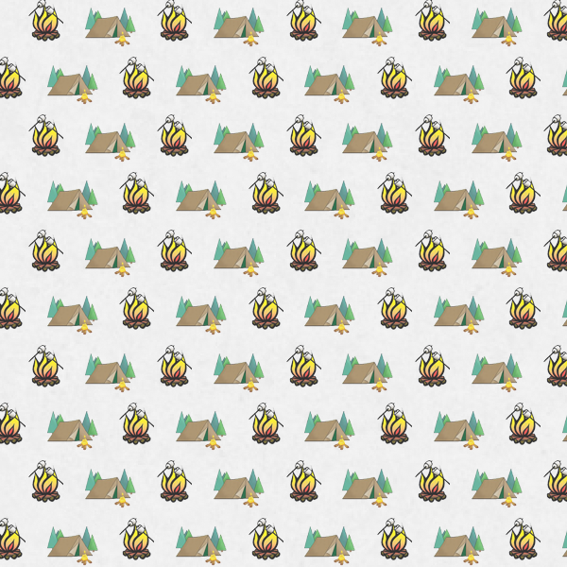

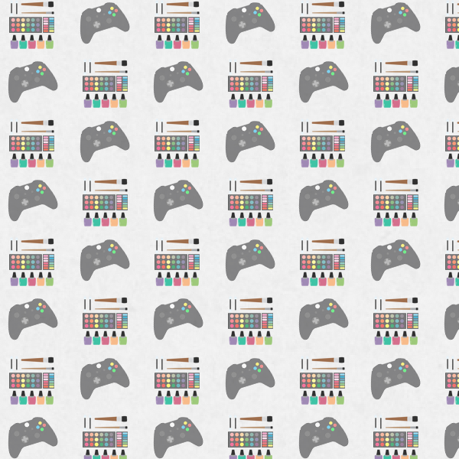
Need a Fun Game???
FabLibs is a PERFECT App For:
Sleepovers
Camping
Game Night
Bachelorette Parties/Bridal Showers
Baby Showers

Slide 3
How To Play!
Grab some friends and start the app. Make an account!
Choose a *Category (Sleepover, Camping, Baby, Bridal).
One player gets suggestions from the group for the words on the form (eg. Noun, Verb, Adjective, Adverb)
The suggestions will be inserted into a FabLib from the chosen category, and a player will read the result to the group.
Hilarity ensues!
Repeat!
If you LOVE a result, you can save it to the Gallery for others to enjoy!
*more Categories are in the works!

Slide 4
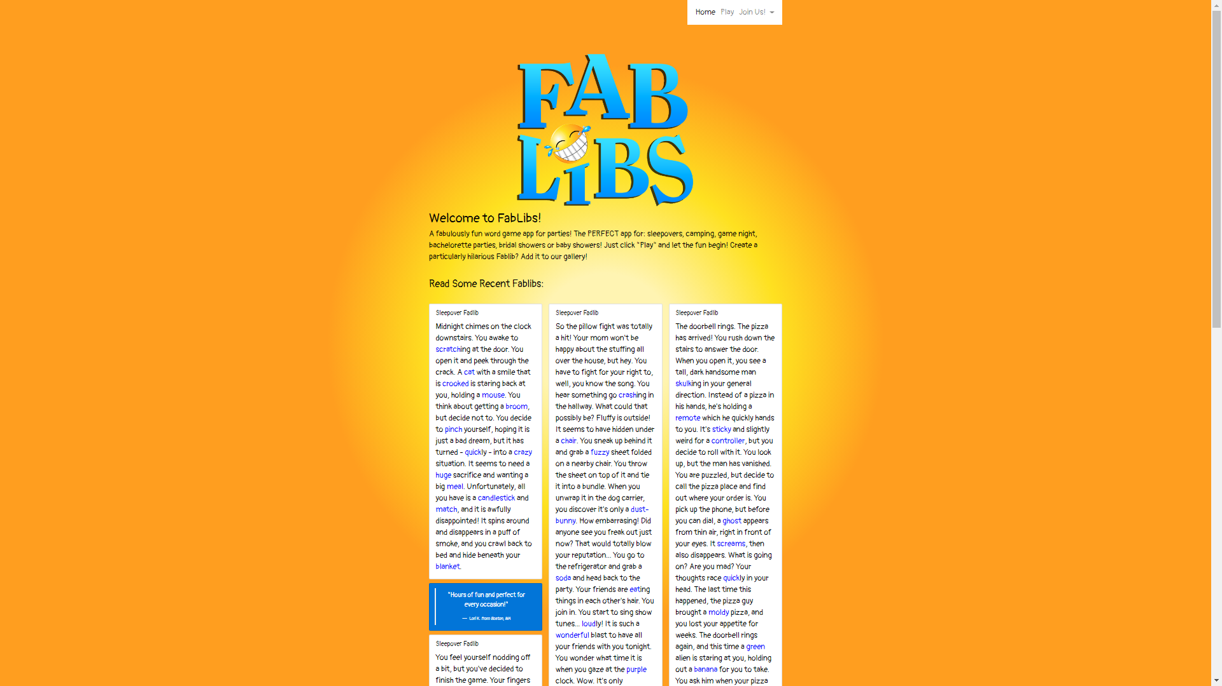

Slide 5
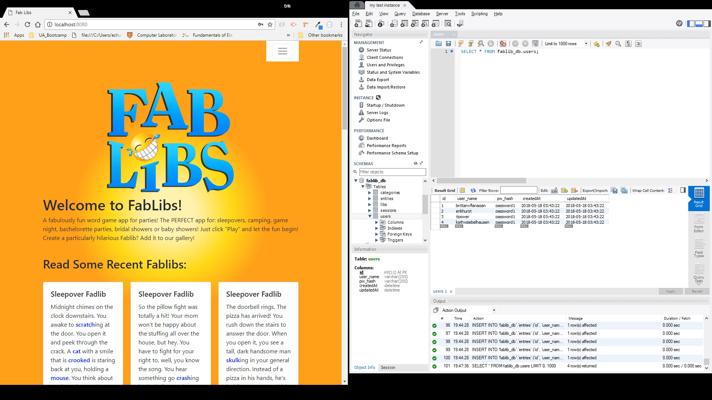
Registration

Slide 6
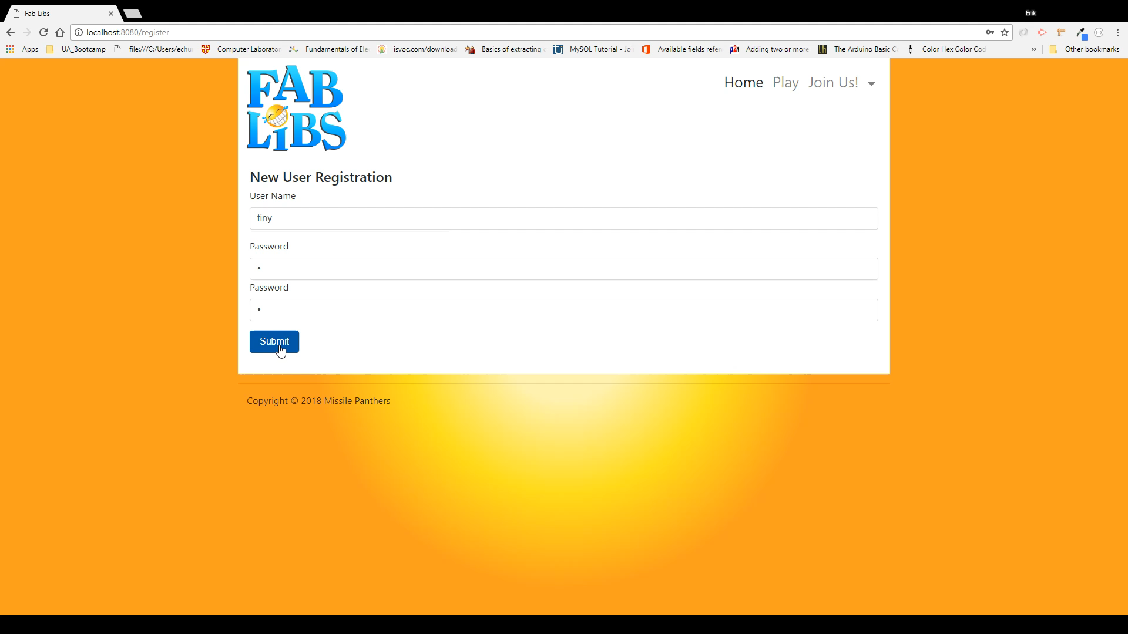
Registration Errors

Slide 7
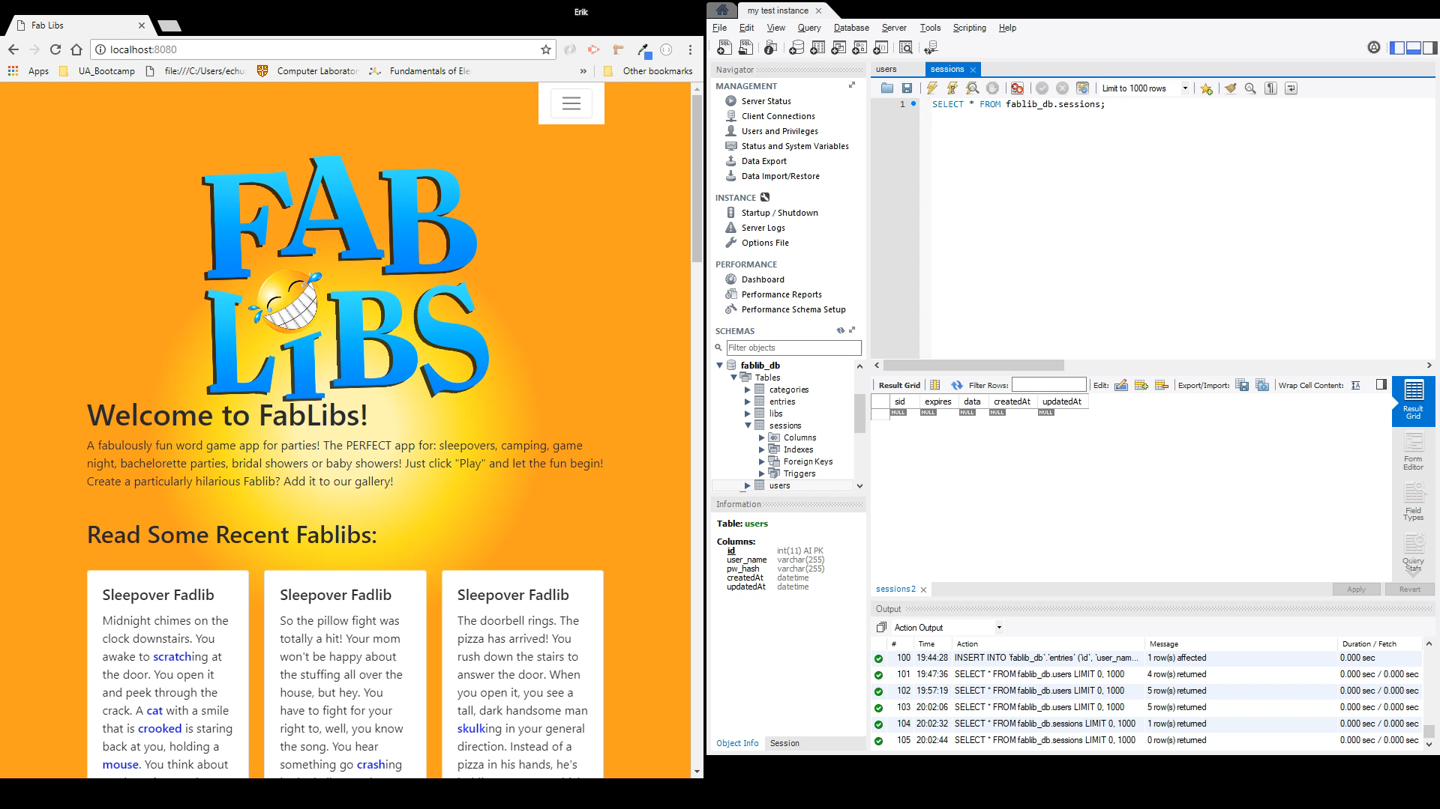
Login

Slide 8
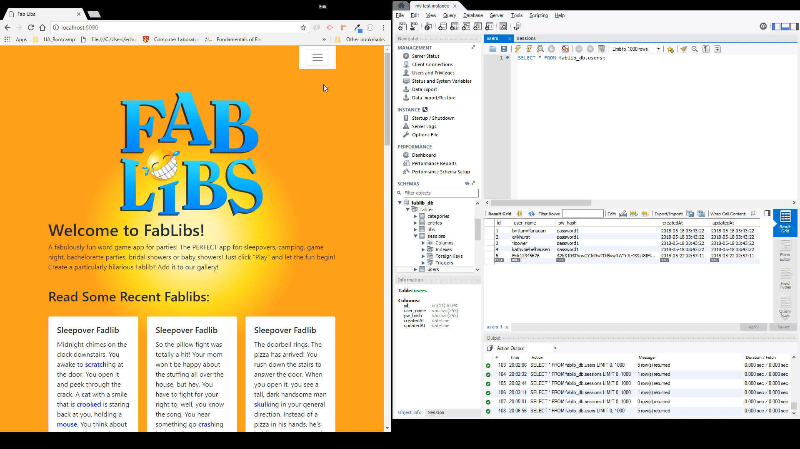
Login Errors

Slide 9
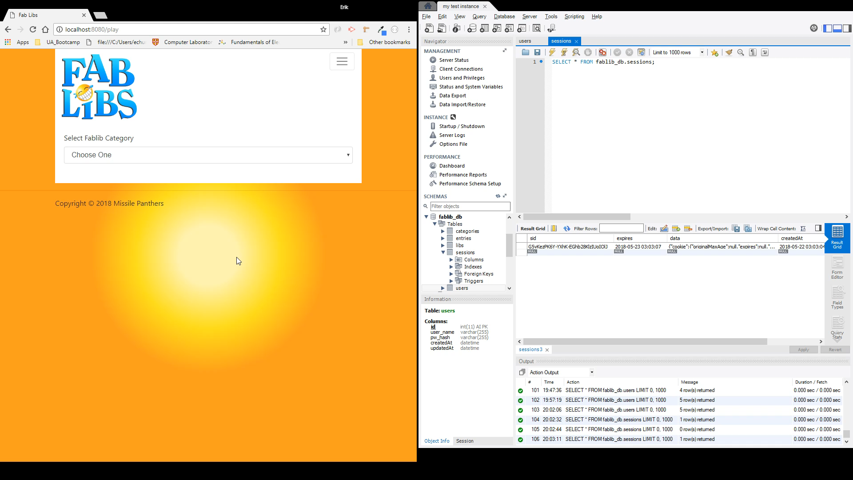
Logout

Slide 10
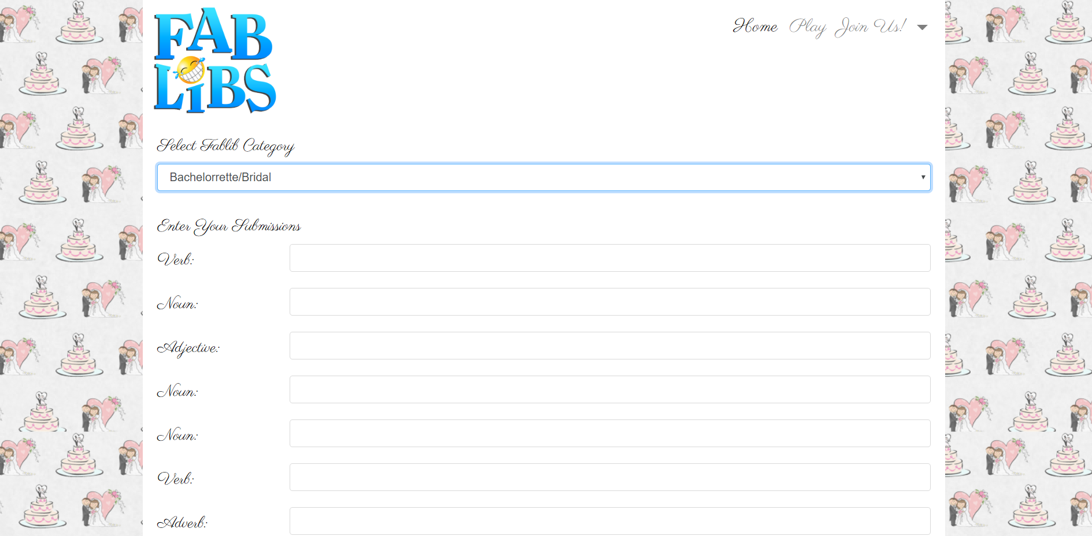
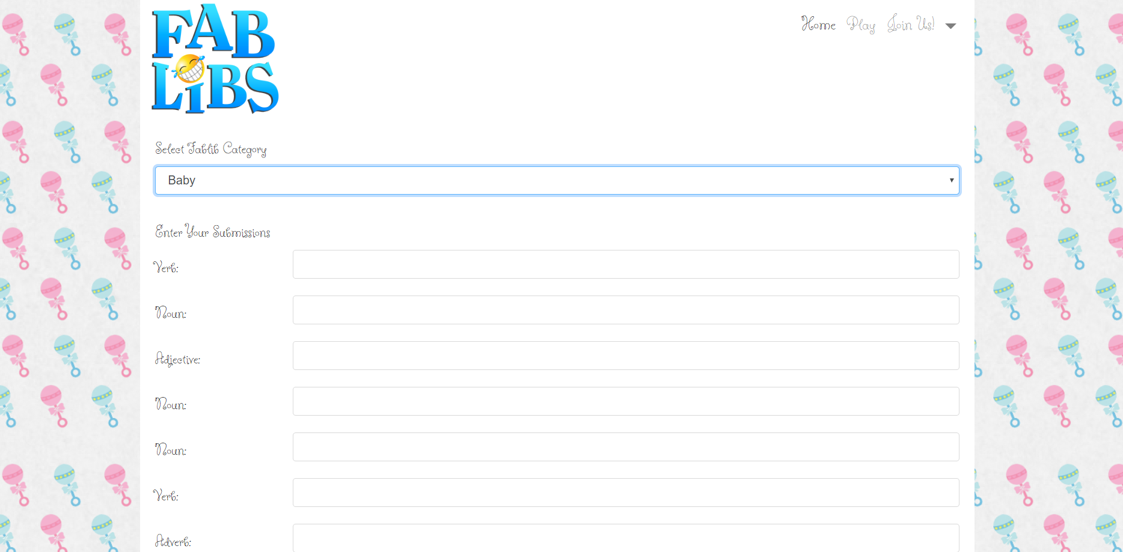
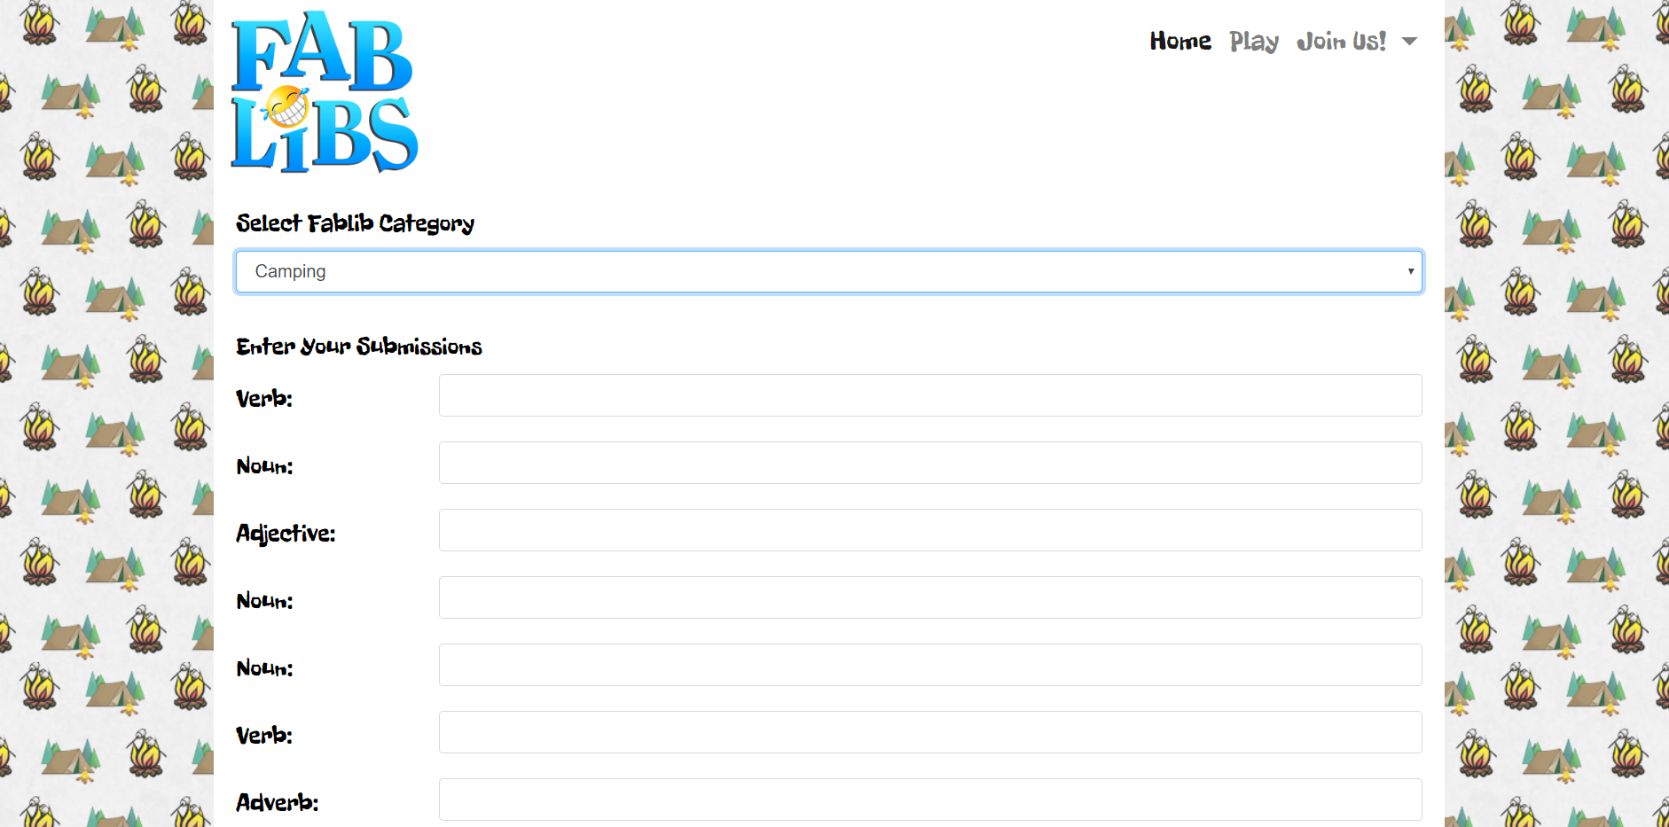
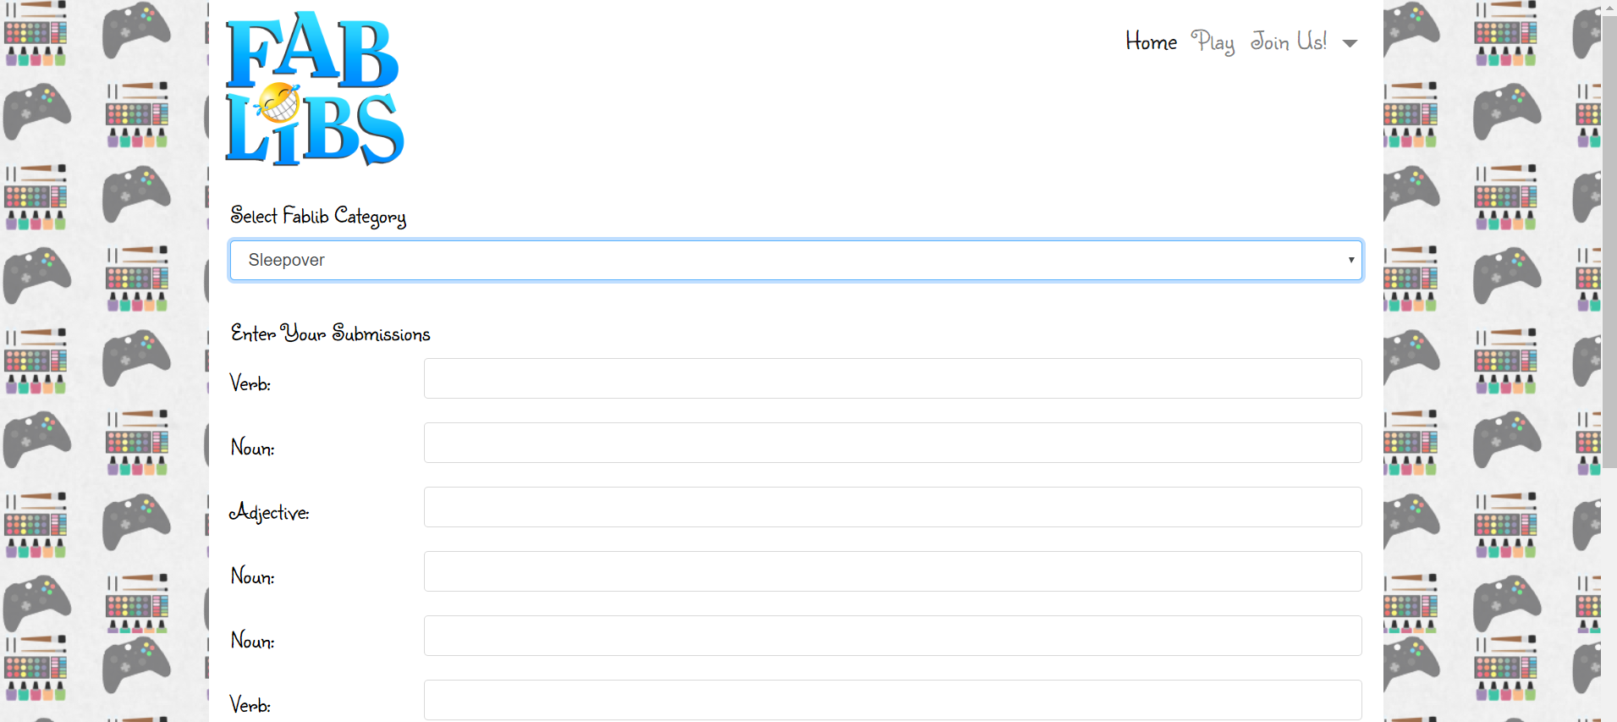
Word Forms

Slide 11
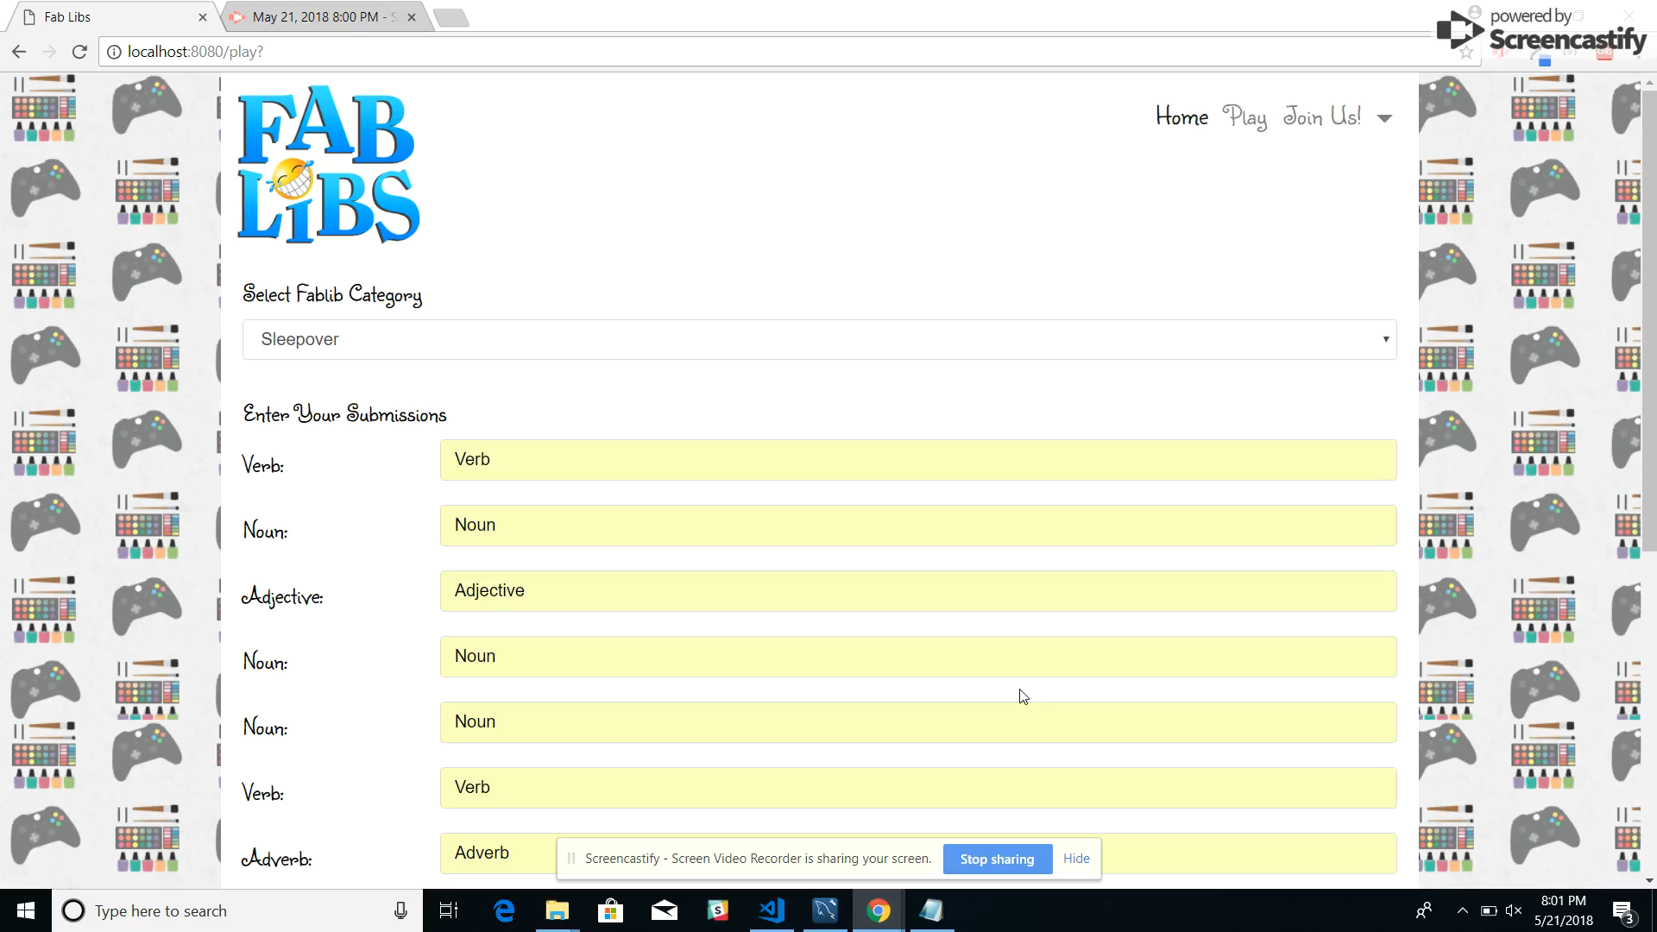
Play!

Slide 12
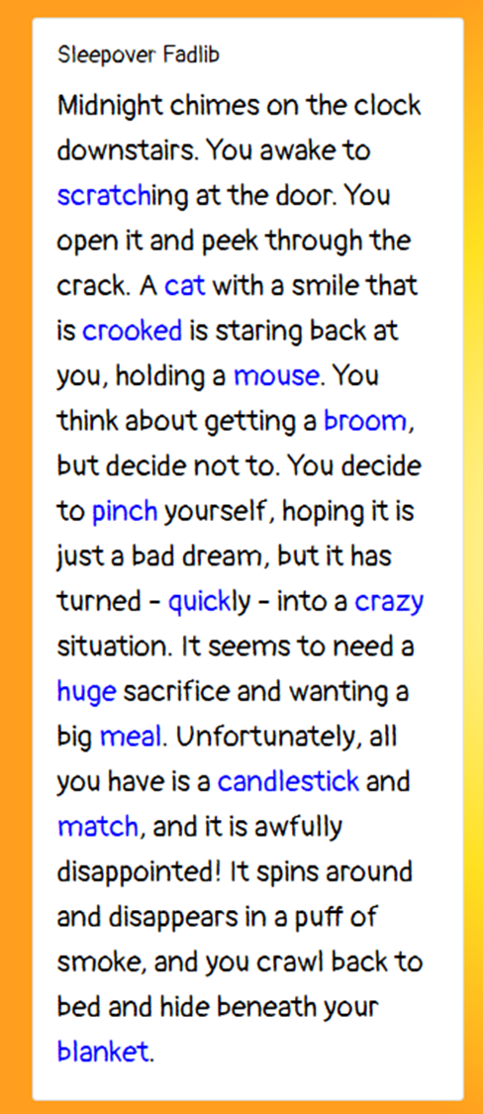


R
E
A
D
!!!
E
N
J
O
Y
!!!

Slide 13
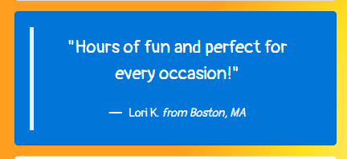
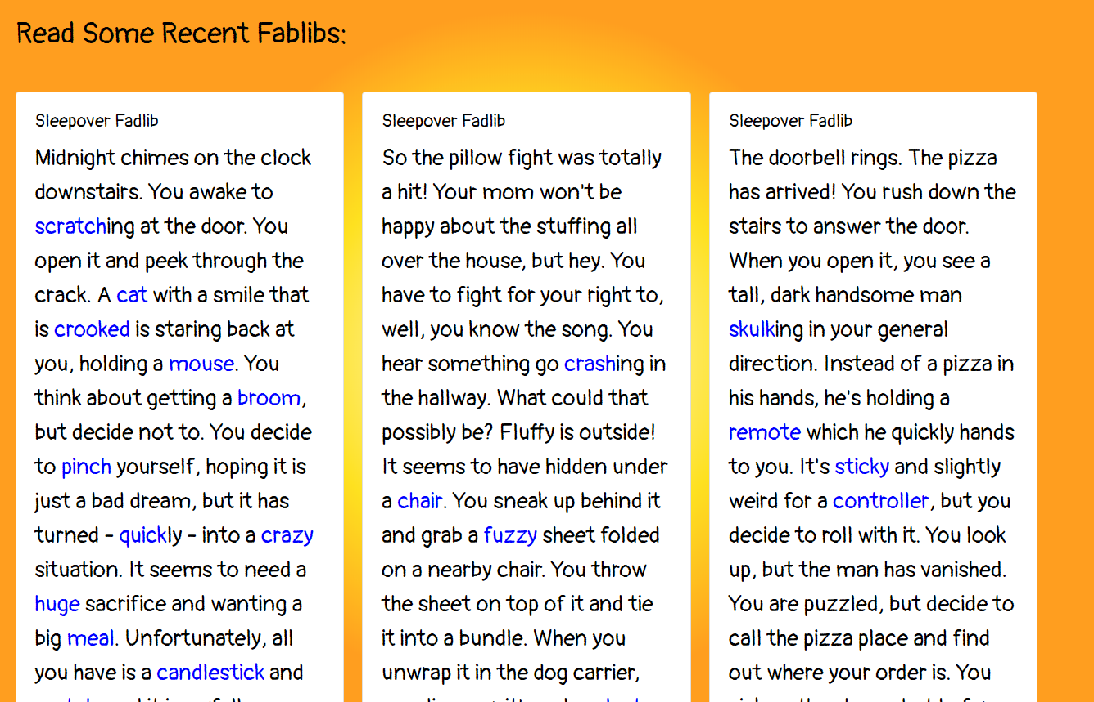

G
A
L
L
E
R
Y

Slide 14
Technologies Used to Create FabLibs
Bootstrap 4.00/CSS3/HTML5
Google Fonts
Handlebars
JavaScript
JQuery
Git/GitHub
Heroku
MySQL
Express / Node JS
NPM fs, dotenv, path, mysql, express, bcrypt, sequelize, body-parser, passport, passport-local, express-session,
Mocha/Chai/Karma

Slide 15
Responsibilities and Challenges
Kathy G.- Front End: Logo, Backgrounds, Bootstrap, CSS, Logo Animation
README
J.J. P.- Front End: Bootstrap, CSS, Google Fonts, Scripts Back End: Switch statement for CSS,
MySQL, Seed Data, PowerPoint Presentation
Erik H.- Back End: User Authentication, Routing, Repo Admin, Form Validation for Form
Registration and Authentication, Testing, Troubleshooting
Brittany F.-Back End: CSS, Gallery, MySQL Database, Handlebars, Routing, Game
Functionality

Slide 16
FabLibs 2.0!
More Categories and FabLibs!
Make possible for user to save favorite FabLibs in a personal Gallery.
Expand number of FabLibs displayed in Gallery.
Sort Galleries by favorite Category.
Add a voting feature that allows user to like their favorite FabLibs in the Gallery.

Slide 17

Thanks for Playing!
Missile Panthers 2018©

